Slide 1
Module 2 UAS - Intro
Part 2.6
Ethical and Legal Aspects

Slide 2
Ethical aspects of UAS operations
Similar issues with any other technology usage
Values that we stand for
Freedom
Responsibility
Respect
Safety
Sustainability
Security
Privacy
Protection

Slide 3
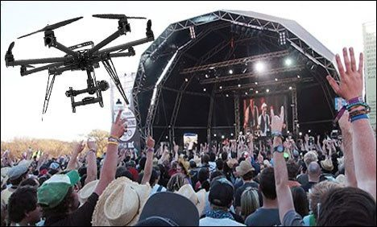
Ethical aspects of UAS operations

Slide 4
Ethical aspects of UAS operations

Slide 5
Ethical aspects of UAS operations

Slide 6
Ethical aspects - Freedom
UAS operators should be allowed to use UAS under given regulatory framework
Regulatory framework should be clear and easy to follow

Slide 7
Ethical aspects - Responsibility
UAS operators are responsible to operate UAS in compliance with existing regulatory framework
On top of that, UAS operators are responsible for their actions therefore for entire flight operation, from take off till landing
UAS Operators are also responsible for data they collected during UAS operations
UAS operators should foresee potential hazard situations and take actions to avoid them
UAS operators are responsible to keep operational excellence at the highest possible standards

Slide 8
Ethical aspects - Respect
UAS operators must operate UAS with respect to other stakeholders
Distance from 3rd party persons or property
Noise
Privacy when taking footage
Overall safety

Slide 9
Ethical aspects - Safety
UAS operators must prioritize safety over all other aspects
Every flight has to be briefed with respect to safety
The way UAS is being used should be within limits
Regular maintenance
Regular training
No “funny” hazards
Sticking with safety procedures and practices – checklists, briefings etc.

Slide 10
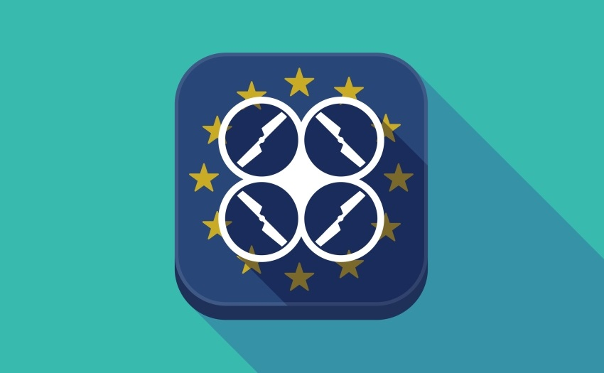
Legal aspects – Regulatory framework
UAVs are aircrafts
Share the same airspace with other traffic
UAVs rules are a bit different
Regulatory body is FAA in U.S.A. and EASA in EU
EASE issued new rules
Focus on risk management
Local Civil Aviation Authorities are in the process of implementing this framework
Consistent across EU

Slide 11
Legal aspects – Regulatory framework
UAS operators / pilots have to register with local CAA – should be available as online service
Pilots need to pass online tests to be able to operate in Open Category
Open category – wide category for public usage
Specific category – professional operations with limits
Certified category – professional operations with less limits but highest requirements on operator and UAVs
Category for drones – C0 – C5

