Slide 1
Module 2 UAS - Intro
Part 2.5
Business Scenarios

Slide 2
UAS – Business Scenarios
Civil businesses started to explore UAS capabilities
UAV – just vehicle
UAS – entire system, including sensors, ground station etc.
RPAS – Remotely piloted aircraft system = UAS
UAS got much cheaper than military products

Slide 3
UAS – Scenarios - Photogrammetry
Cheap way how to get images of targeted area
Additional information about GPS position and Altitude for every image
Software tools to put images together and build 3D or 2D model
Orthophoto imagery
Align final imagery to the real coordinates model – enables measuring

Slide 4
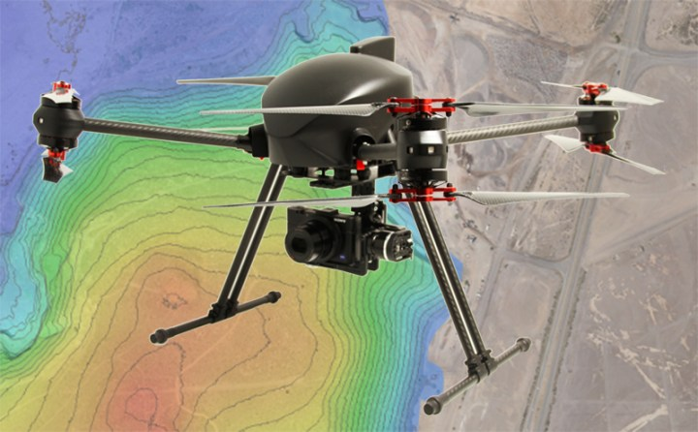
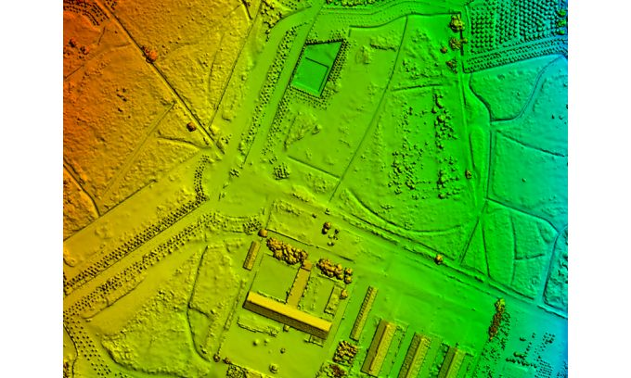
UAS – Scenarios - Photogrammetry

Slide 5
UAS – Scenarios – Video capturing
New areal techniques to get action videos
concept of flying camera
sport events, documentaries, news etc...
private footage from holidays...
high quality cameras – 4K
camera stabilization is key feature

Slide 6
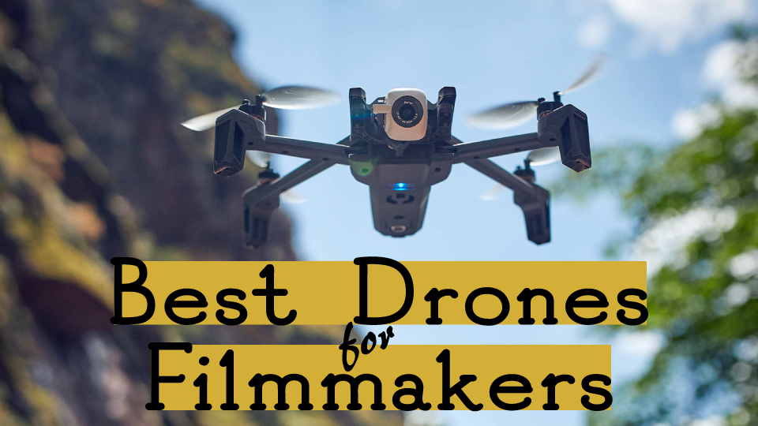
UAS – Scenarios – Video capturing

Slide 7
UAS – Scenarios – Surveillance
Ability to follow patrol track
Combination of optical and thermo cameras
Long range – industrial infrastructure like lines, pipes, roads ...
Short range – buildings, facilities, fields ...
Multirotors, fixed wings, hybrid VTOLs
Real time action

Slide 8
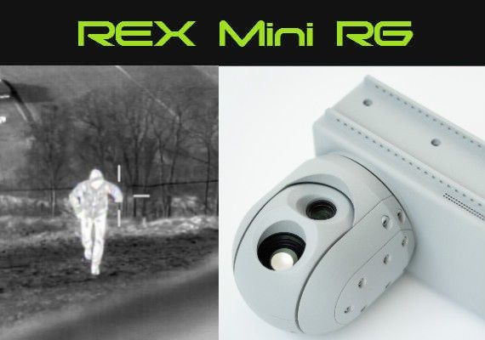
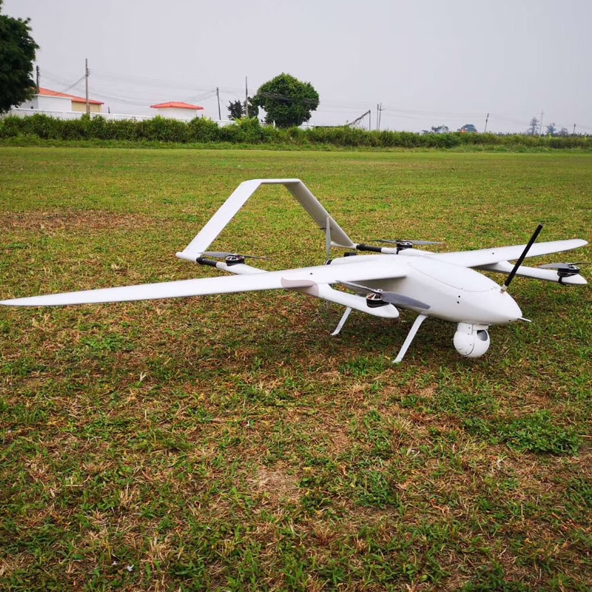
UAS – Scenarios – Surveillance

Slide 9
UAS – Scenarios – Search and Rescue SAR
Ability to scan areas
Combination of optical and thermo cameras
Cell phone detectors, speakers
Short range – buildings, facilities, fields, sectors ...
Multirotors, fixed wings, hybrid VTOLs
Real time action

Slide 10
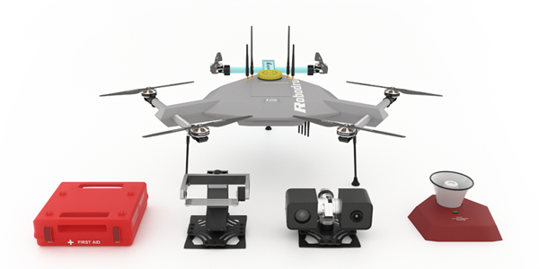
UAS – Scenarios – SAR

Slide 11
UAS – Scenarios – Logistics
Goods transportation
Last mile or non urban areas
Need fully autonomous operation
Inventory
Need regulatory support

Slide 12
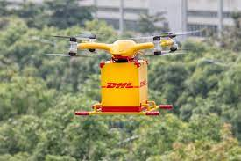
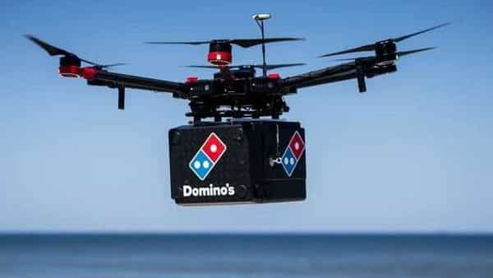
UAS – Scenarios – Logistics delivery

Slide 13
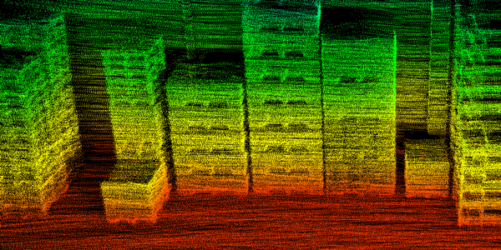
UAS – Scenarios – Logistics inventory

Slide 14
UAS – Scenarios – Agriculture
Precise agriculture
Green, selective approach
Plants health monitoring
Multispectral cameras, LIDARs
Erosion measuring

Slide 15
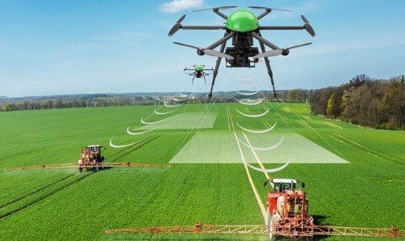
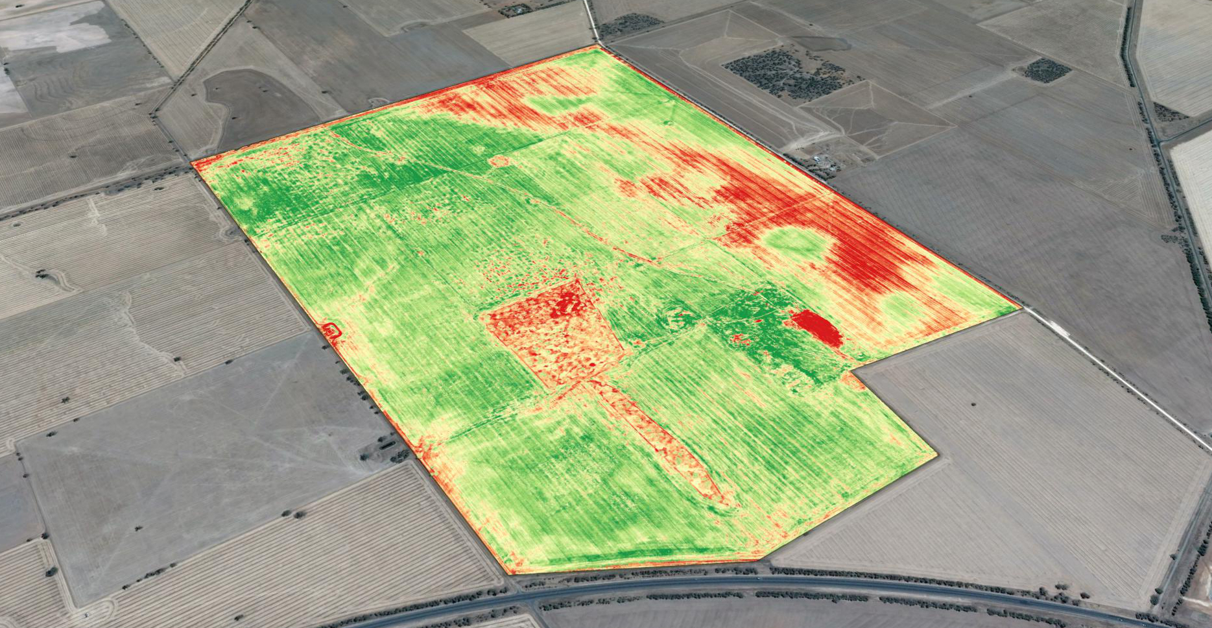
UAS – Scenarios – Agriculture

Slide 16
UAS – Scenarios – Solar panel inspection
Detection of solar panel degradation
Fast monitoring for big power sites
Repeatable measuring
Optimal light conditions
Thermo cameras, LIDARs

Slide 17
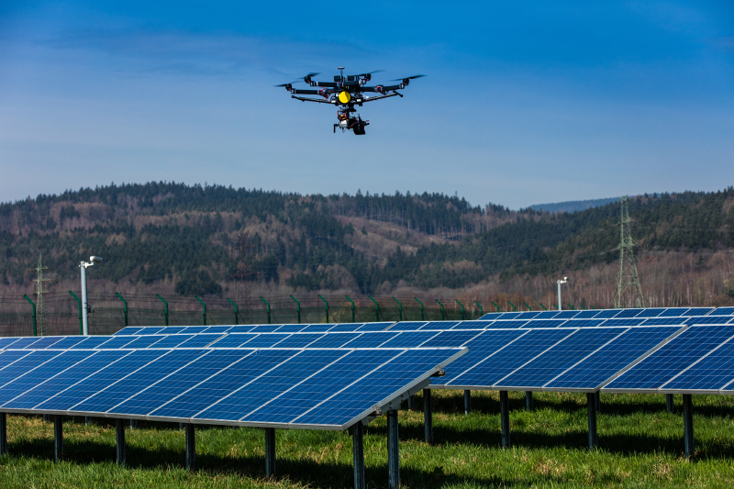
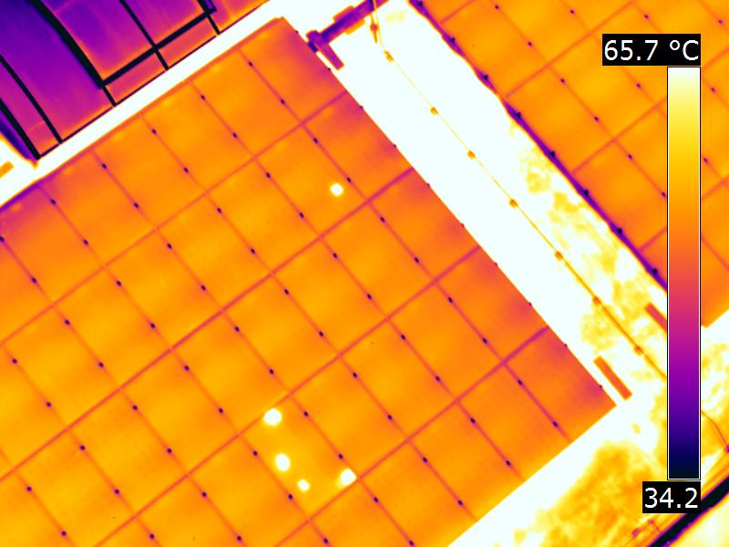
UAS – Scenarios – Solar panel inspection

Slide 18
UAS – Scenarios – Pipelines inspection
Detection of heat leakage
Fast monitoring for long pipelines
Repeatable measuring
Optimal conditions at night or low temperatures
Thermo cameras, LIDARs

Slide 19
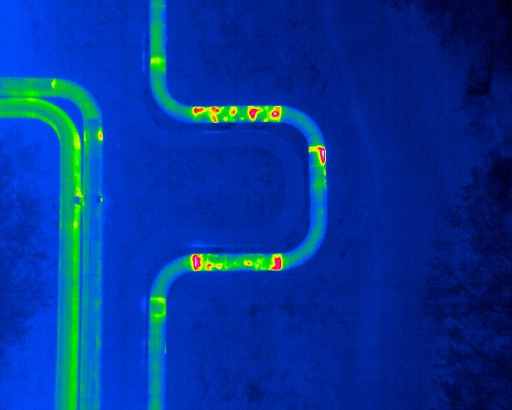
UAS – Scenarios – Pipeline inspection

