Slide 1
Module 2 UAS - Intro
Part 2.4
History of Drones after WWII

Slide 2
UAS – history Lightning bugs
https://en.wikipedia.org/wiki/Ryan_Model_147
reconnaissance RPV
1969 – 1975 – mostly Vietnam war
low and high altitudes
Camera on boards transmitted signal to DC130 controller aircraft
3 435 missions, 554 UAVs lost to all causes
China reverse engineered to Wu Zhen 5

Slide 3
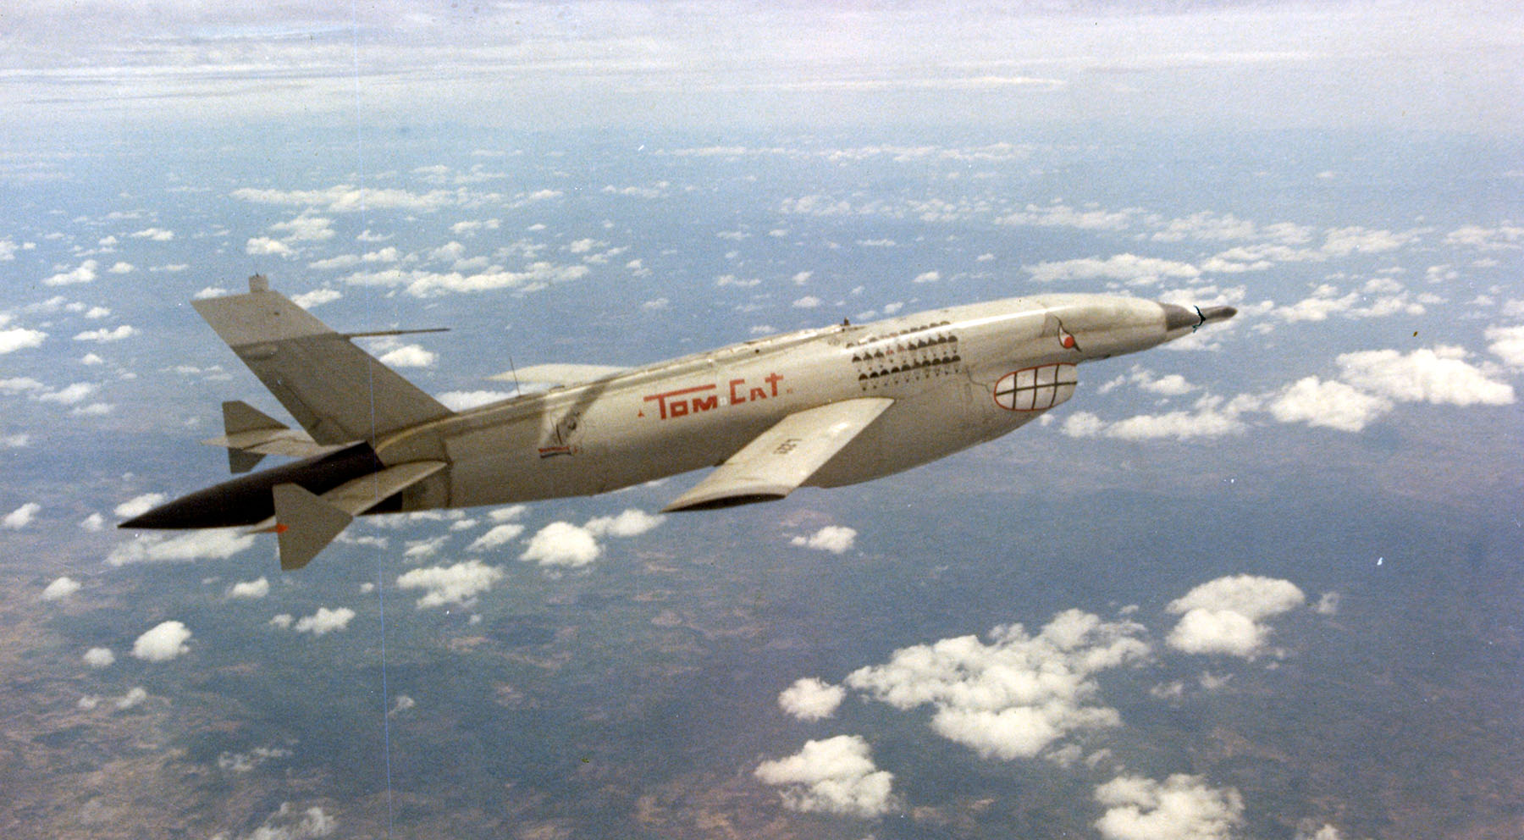
UAS – history Lightning bugs
By United States Air Force - National Museum of the U.S. Air Force photo 140114-F-DW547-004, Public Domain,
https://commons.wikimedia.org/w/index.php?curid=11776512

Slide 4
UAS – history War on Terror
UAVs as unreliable and expensive toys
Israeli Air Force victory over the Syrian Air Force in 1982
Using UAVs helped to destroy dozens of Syrian aircraft with minimal losses
Electronic decoys, jammers, real time video reconnaissance
US military changed strategy
Predator RQ-1L used in Balkans 1995, later Iraq and Afghanistan
https://en.wikipedia.org/wiki/General_Atomics_MQ-1_Predator

Slide 5
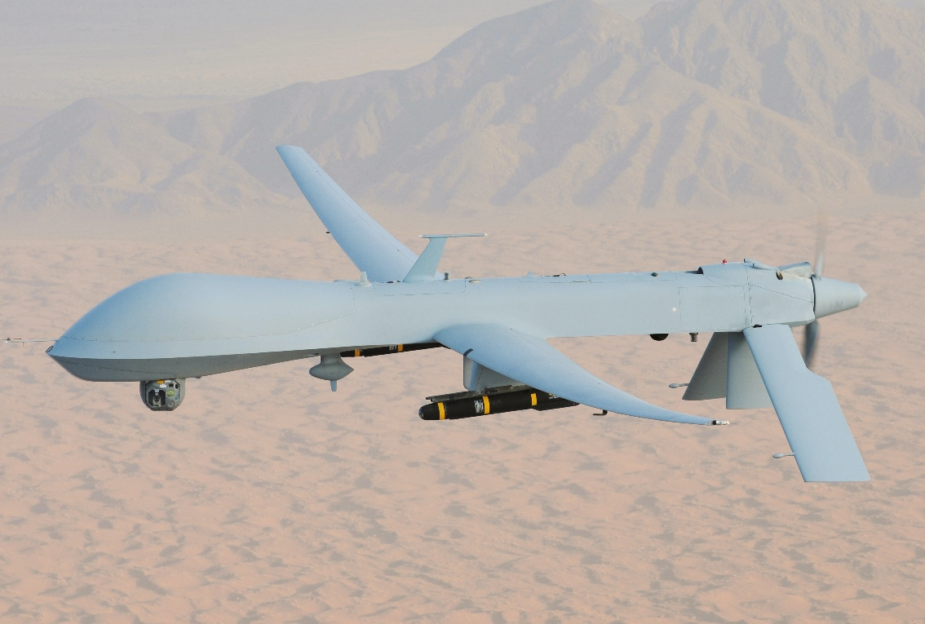
UAS – history War on Terror
By Lt. Col. Leslie Pratt - afrc.af.mil, Public Domain, https://commons.wikimedia.org/w/index.php?curid=68261178

Slide 6
UAS – history U.S. domestic use
U.S. Customs and Border Protection agency
Fleet of MQ-9 Reapers
3900 arrests and seizure of 4 tons of marijuana in 6 months of service
2005 Hurricane Katrina, SAR operations needed
UAVs could not be used as FAA had no authorization in place at the time

Slide 7
UAS – history Miniature UAV
Fast development of electronic devices
Mass volume and low price
UAV small enough to be man-portable
Primary areal photography and real time video relay
Shift from military to research and public users
Sensors development

Slide 8
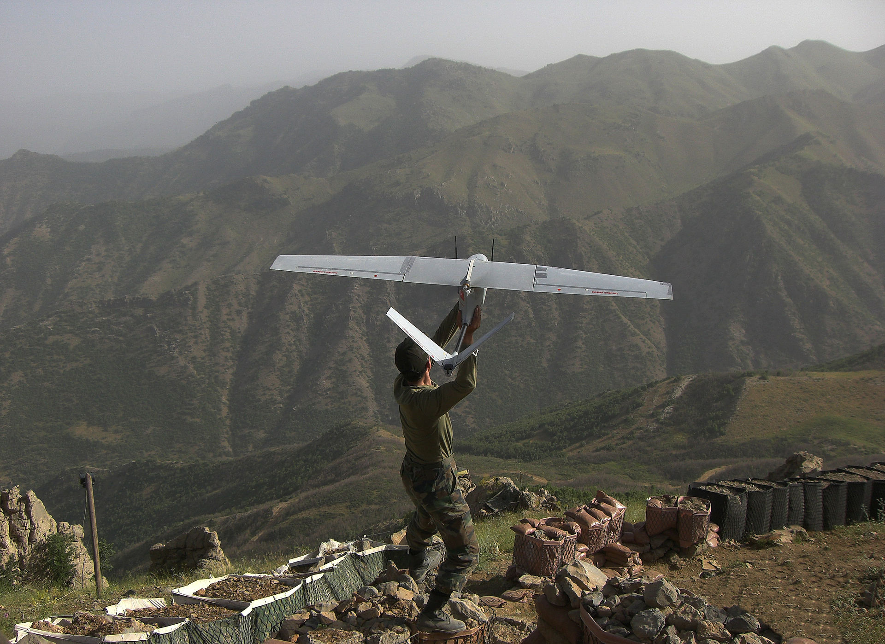
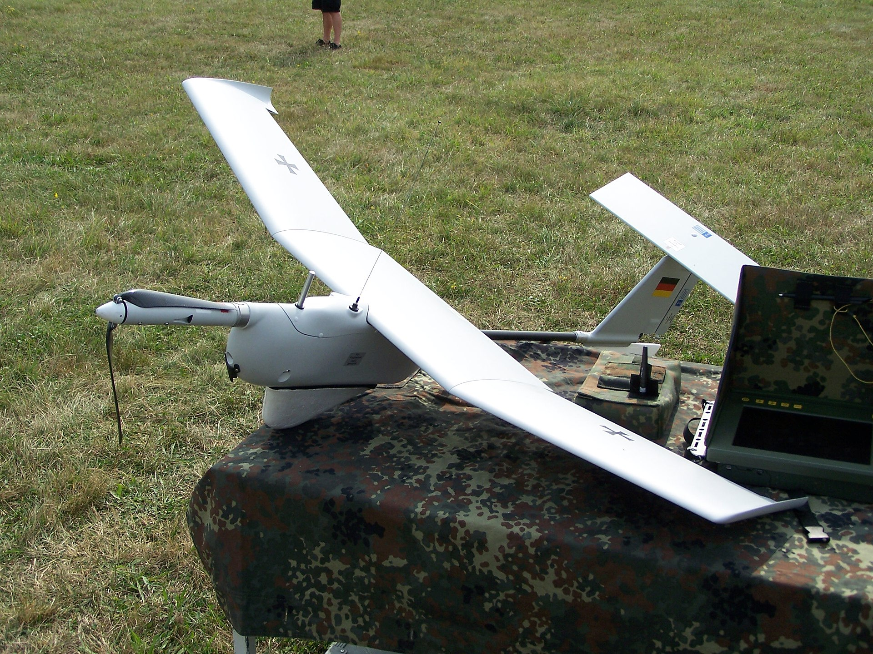
UAS – history Miniature UAV
By Bayhaluk - Own work, CC BY-SA 4.0, https://commons.wikimedia.org/w/index.php?curid=34668110
By KrisfromGermany - Own work, Public Domain, https://commons.wikimedia.org/w/index.php?curid=4574875

Slide 9
UAS – history VTOL - copters
VTOL – vertical take off and land
Helicopters also used as UAVs but expensive
Rotor head mechanical complexity

Slide 10
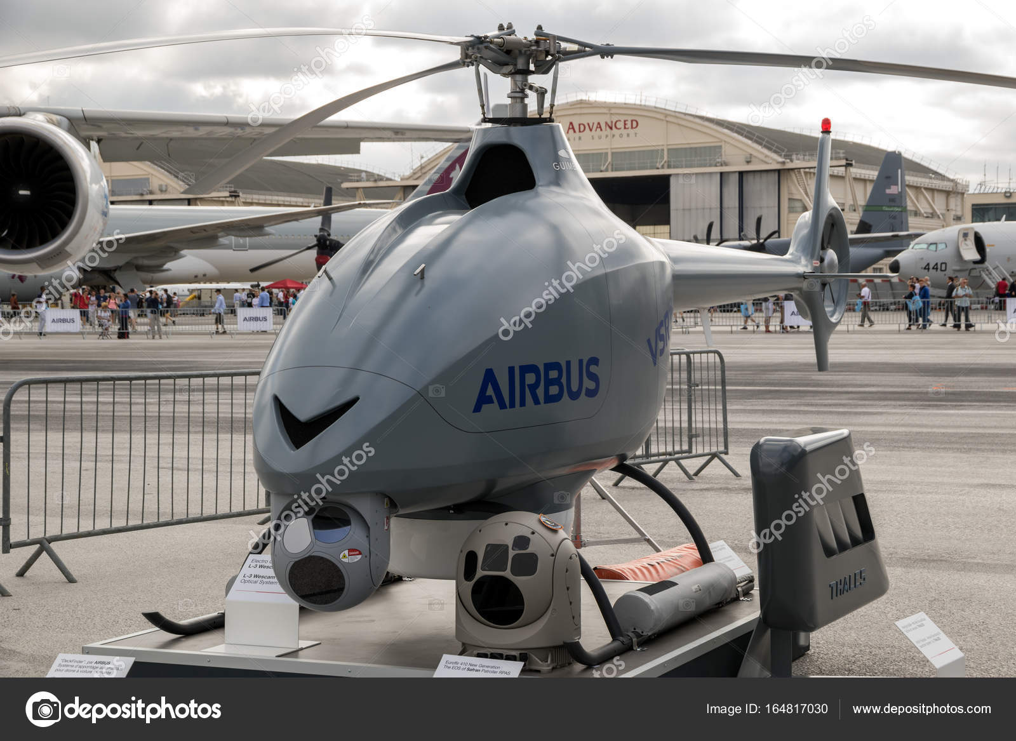
UAS – history Helicopter UAV
PARIS, FRANCE - JUN 23, 2017: VSR700 autonomous helicopter drone at the Paris Air Show 2017. — Photo by Foto-VDW

Slide 11
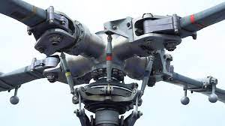
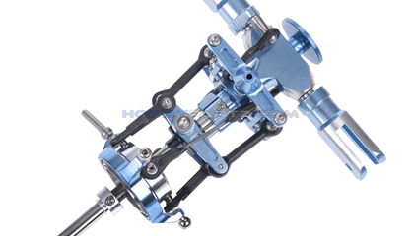
UAS – history Rotor head

Slide 12
UAS – history VTOL - copters
Helicopter design still to complex and expensive
1 rotor is fine but what about 4 rotors?
Stabilization problem
Electronic and software solution instead of mechanical solution

Slide 13
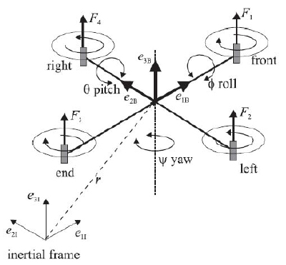
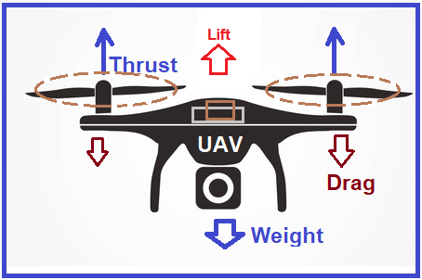
UAS – history Quad copter design

Slide 14
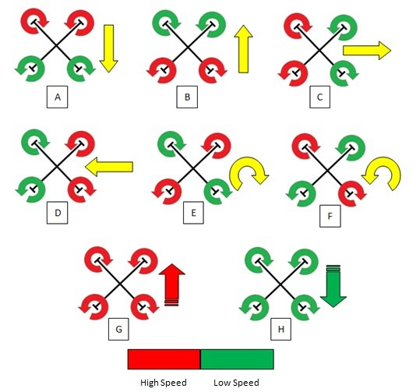
UAS – history Quad copter design

Slide 15
UAS – history VTOL - copters
To stabilize and control drone along all axes only motors RPMs control is needed
Electrical design
Enough thrust to lift entire drone
Advances in battery design – LiPol, LiIon

Slide 16
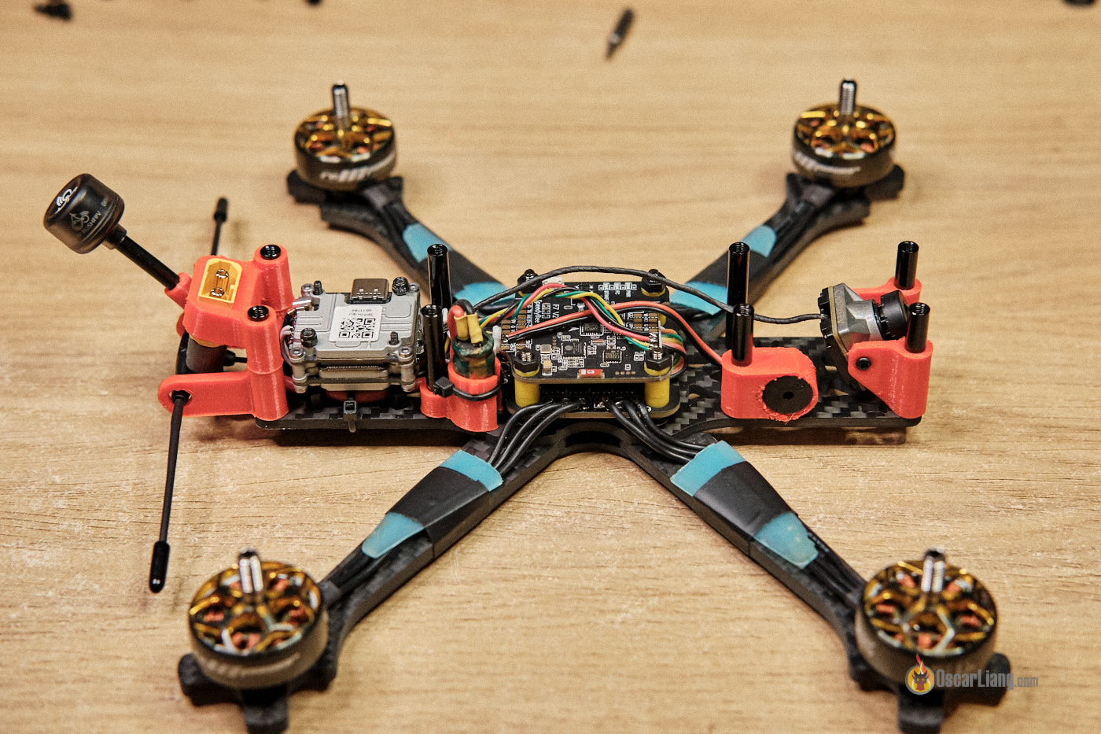
UAS – history Quad copter design

