Slide 1
Module 2 UAS - Intro
Part 2.3
History of Drones till WWII

Slide 2
UAS – history – Queen IIIF
https://en.wikipedia.org/wiki/Fairey_III
1931 – radio controlled
3 pcs
Used as gunnery target before WWII
Length: 10 m
Wingspan: 14 m
Empty weight: 1749 kg
Power: 430 kW
Speed: 190 km/h
Range: 2450 km

Slide 3
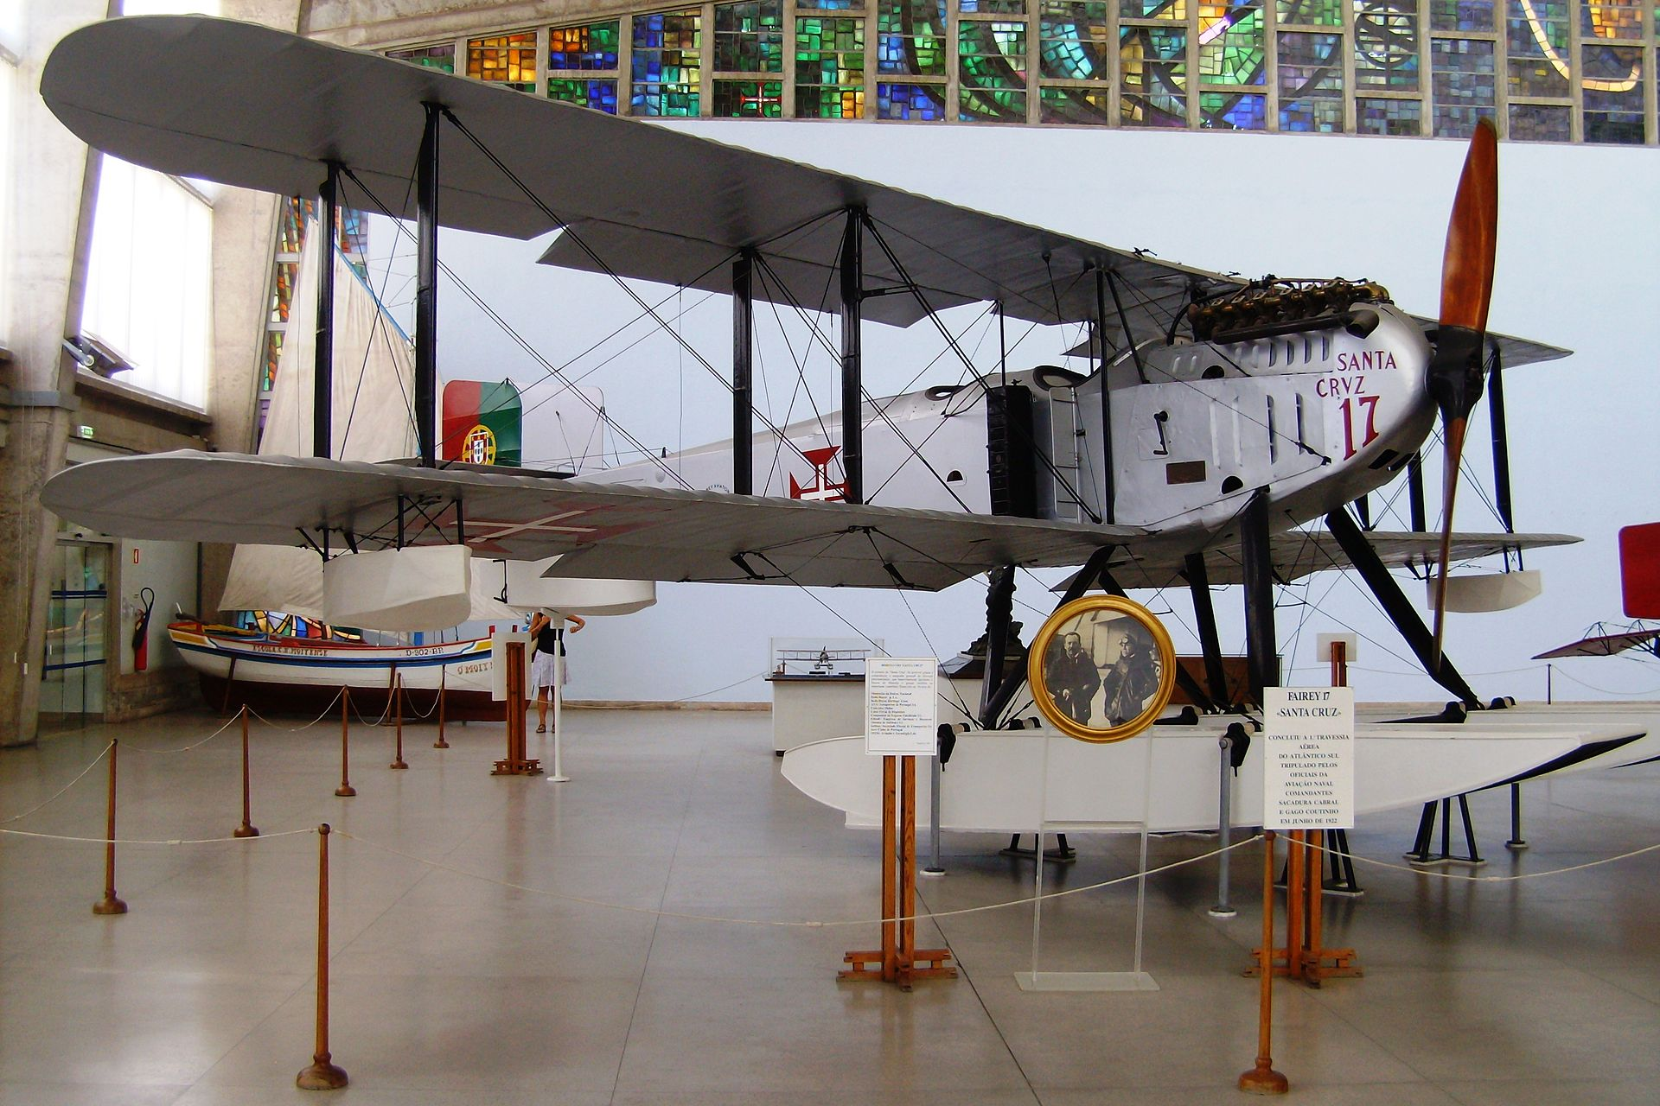
UAS – history – Queen IIIF

Slide 4
UAS – history – Airspeed Queen Wasp
https://en.wikipedia.org/wiki/Airspeed_Queen_Wasp
1937 – first flight
Radio controlled but also manual controls
Backup systems on batteries
Pilotless target
Length: 7 m
Wingspan: 9.45 m
Empty weight: 1588 kg
Power: 260 kW
Speed: 277 km/h
Range: 2450 km

Slide 5
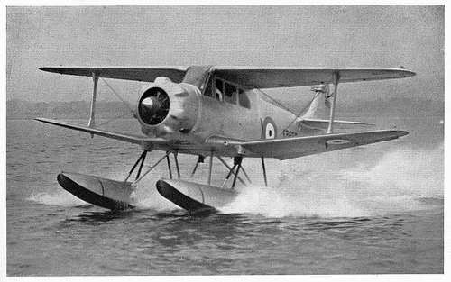
UAS – history – Airspeed Queen Wasp

Slide 6
UAS – history USA
https://en.wikipedia.org/wiki/History_of_unmanned_aerial_vehicles
1936: Head of U.S.Navy research group used the term “drone” to describe radio controlled aerial targets
1938: Reginald Denny demonstrated RP-1 – prototype target drone, RC aircraft
1940: RP-4 as Radioplane OQ-2
Used from 1944 in WWII, 15 000 units
Length: 2,65 m
Wingspan: 3,73 m
Empty weight: 47 kg
Power: 5 kW
Speed: 137 km/h
Endurance: 60 minutes

Slide 7
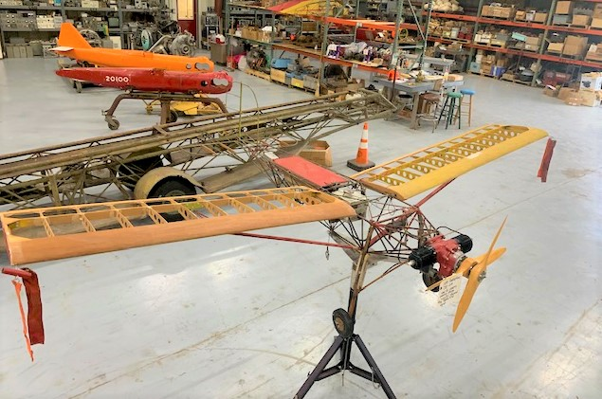
UAS – history OQ-2

Slide 8
UAS – history – Arado As 292
https://en.wikipedia.org/wiki/Argus_As_292
1939 – remotely controlled flight
On board cameras
Used in 1942-1943 WWII
Length: 2,4 m
Wingspan: 2,4 m
Empty weight: 27 kg
Power: 2,2 kW
Speed: 100 km/h
Endurance: 30 minutes
Avionics + control system: 3 kg

Slide 9
UAS – history V-1
flying bomb
https://en.wikipedia.org/wiki/V-1_flying_bomb
1939 – started development
On board 850kg warhead
Used from 1944 in WWII, 9 521 units
Length: 8,32 m
Wingspan: 5,37 m
Empty weight: 2150 kg
Power: 3,53 kN
Speed: 640 km/h
Endurance: 23 minutes
Range: 250 km
Avionics: Gyrocompas autopilot

Slide 10
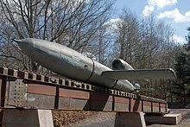
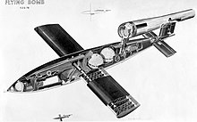
UAS – history V-1

Slide 11
UAS – history TD2D Katydid
target drone
https://en.wikipedia.org/wiki/McDonnell_TD2D_Katydid
1941 – started development
Used from 1942 in WWII
Length: 3,40 m
Wingspan: 3,70 m
Empty weight: 145 kg
Power: 0,27 kN
Speed: 400 km/h
Endurance: 40 minutes
Range: 300 km

Slide 12
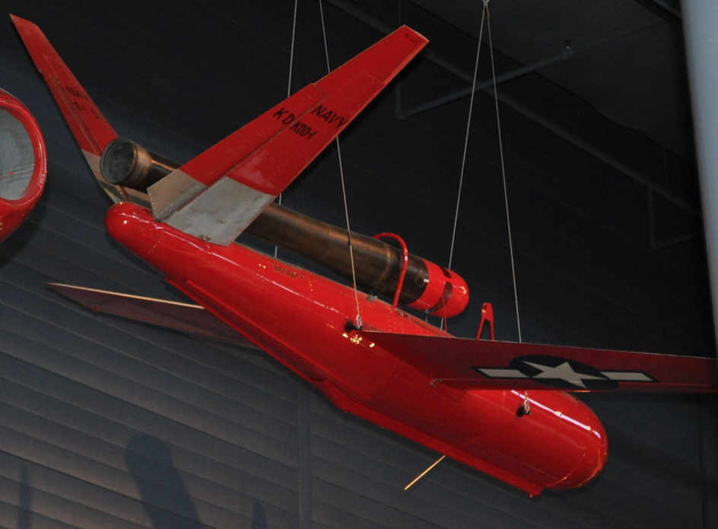
UAS – history TD2D Katydid
By Sturmvogel 66 - Own work, CC BY-SA 3.0, https://commons.wikimedia.org/w/index.php?curid=12518381

Slide 13
UAS – history BVLOS
https://en.wikipedia.org/wiki/History_of_unmanned_aerial_vehicles
BVLOS – beyond line of sight
Edward Sorensen – US patents
To know from ground terminal, what the airplane is doing
Receive back information about :
climbing, altitude, banking, direction, rpm, other instrumentation
1942 – assault drone delivered torpedo attack on destroyer
first television camera on board, transmitting signal to TG-2 control aircraft

