Slide 1
Module 2 UAS - Intro
Part 2.2
History of Navigation

Slide 2
Navigation – principles – 3000 years old ☺
https://en.wikipedia.org/wiki/Navigation_system
Naval systems
Heading, Velocity, Position

Slide 3
Navigation – principles
Y
y_{B}
B
s² = delta_{x}² + delta_{y}²
t – time
v – velocity
s = v * t
A, Heading, Velocity, Time -> B
delta_{y} = y_{B} - y_{A}
heading
A
y_{A}
delta_{x} = x_{B} - x_{A}
x_{A}
x_{B}
X

Slide 4
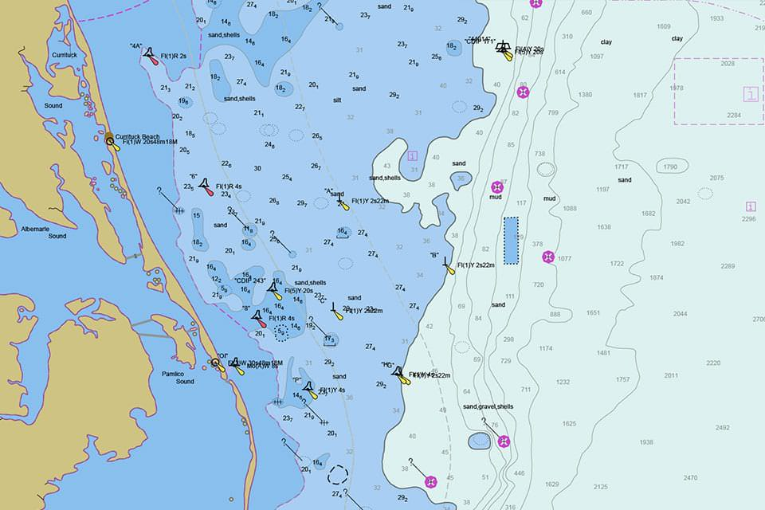
Navigation – principles – maps

Slide 5
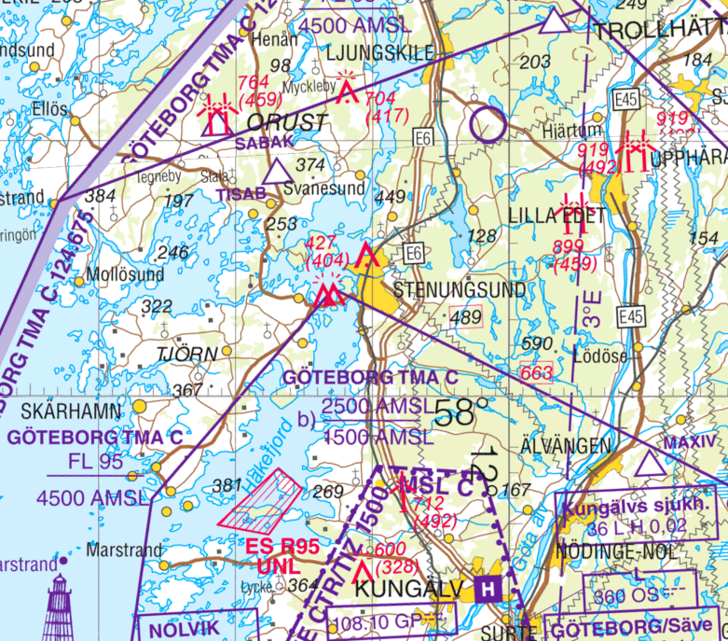
Navigation – principles – maps

Slide 6
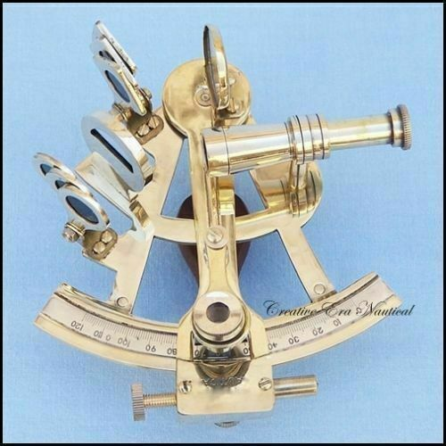
Navigation – principles – position
Star
A
alfa
B
beta
Surface

Slide 7
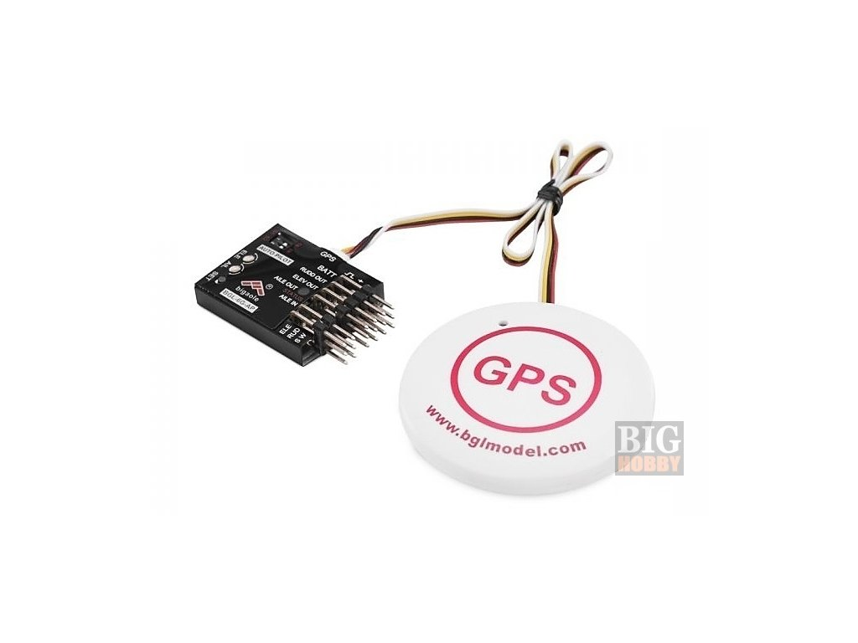
Navigation – principles – position
Satellite
S_{A}
S_{B}
A
alfa
B
beta
Surface

Slide 8
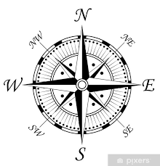
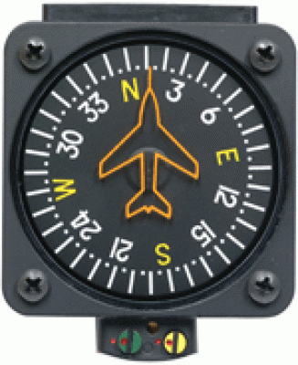
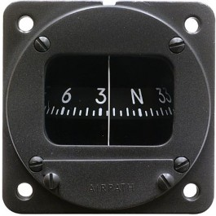
Navigation – principles – heading

Slide 9
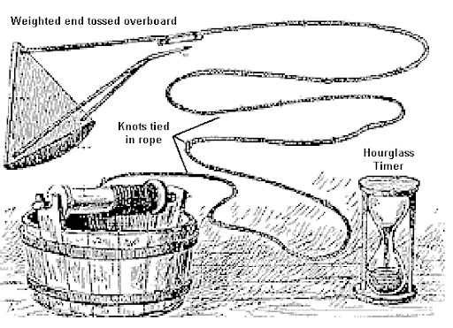
Navigation – principles – speed - water

Slide 10
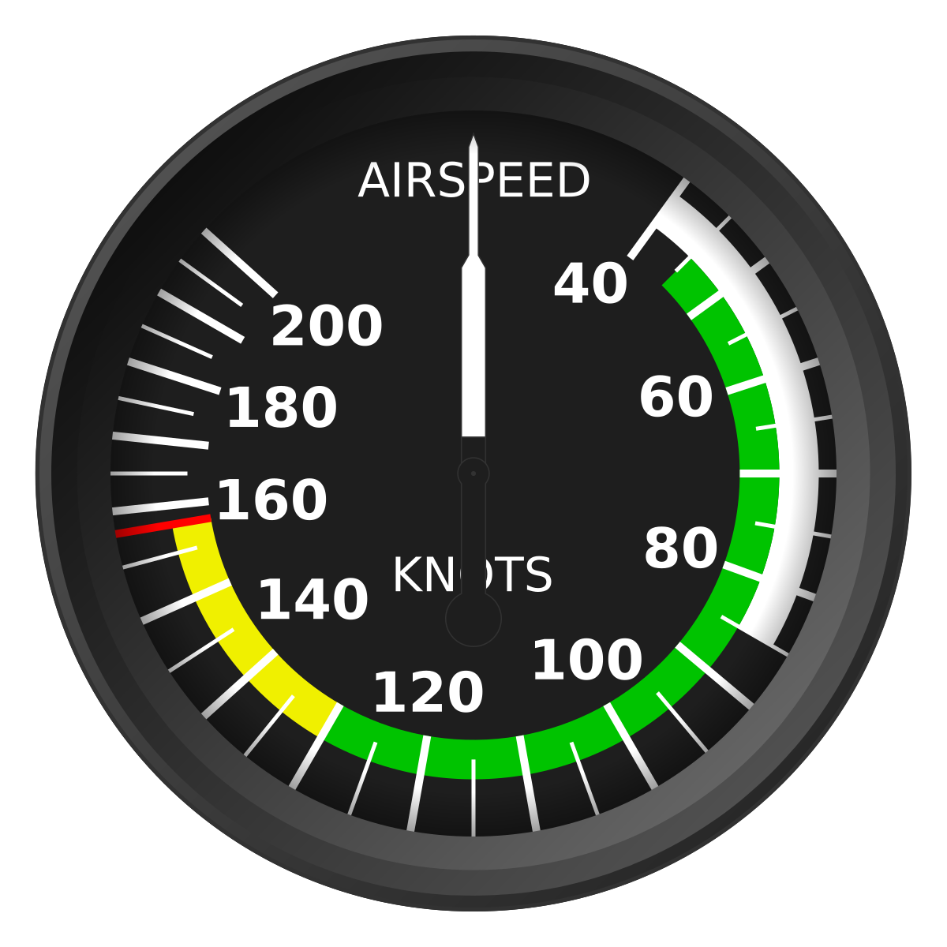
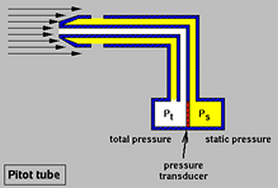
Navigation – principles – speed - air

Slide 11
Control systems - IMU
https://en.wikipedia.org/wiki/Inertial_measurement_unit
Inertial system
Measurements in all 3 axis
Linear acceleration – accelerometer
Rotational acceleration – gyroscope
Heading – magnetometer (aka compass)

Slide 12
Control systems – IMU

Slide 13
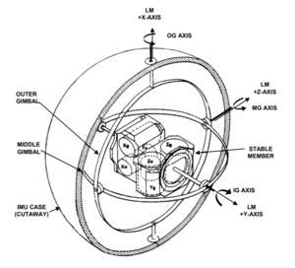
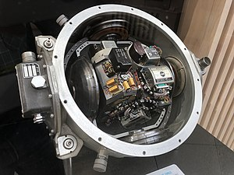
Control systems – Apollo IMU
Apollo IMU, where Inertial Reference Integrating Gyros (IRIGs,Xg,Yg,Zg) sense attitude changes,
and Pulse Integrating Pendulous Accelerometers (PIPAs,Xa,Ya,Za) sense velocity changes

Slide 14
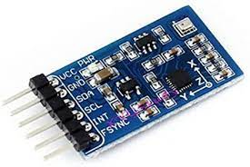
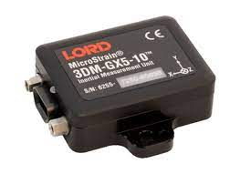
Control systems – IMU modern electronics

Slide 15
Control system schema
Preset value
Diff Amplifier
Actuator
Control
IMU

