Slide 1
Module 2 UAS - Intro
Part 2.1
History of Automatic Control

Slide 2
History of automatic control
Automatic flying
Long history within aviation
How to maintain stabilized flight –> Autopilot systems
How to navigate aircraft to the destination -> Navigation systems

Slide 3
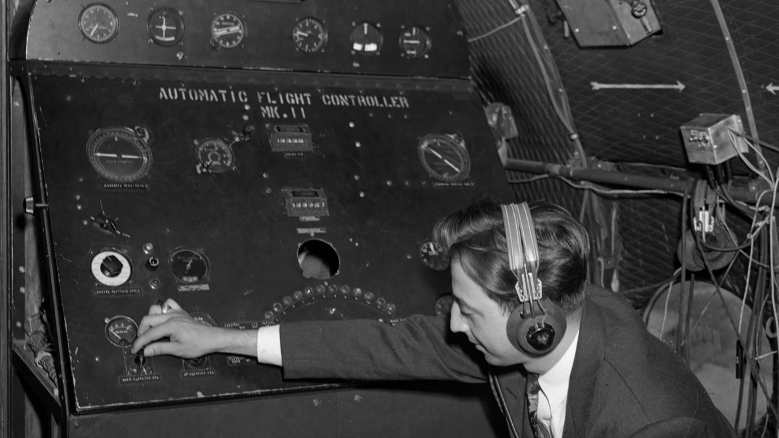
History of automatic control

Slide 4
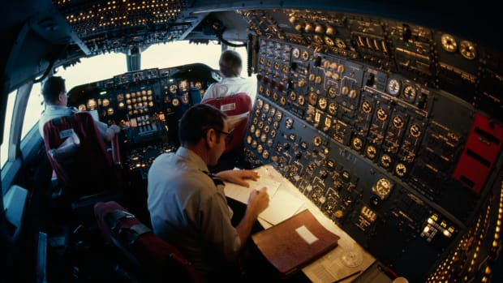
History of automatic control

Slide 5
Autopilots - principles
https://en.wikipedia.org/wiki/Autopilot
First Sperry Corporation in 1912
Heading and Altitude
Demonstrated in 1914 at aviation safety contest in Paris

Slide 6
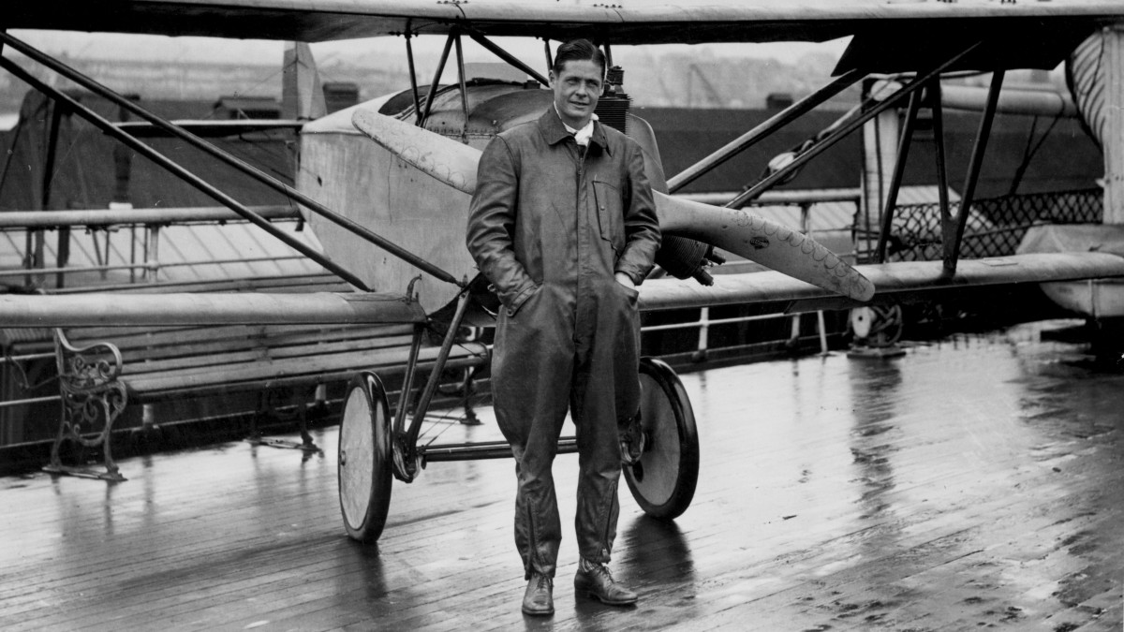
Autopilots - principles

Slide 7
Autopilots - principles

Slide 8
Autopilots – flight control video

Slide 9
Autopilots – schema – 110 years old ☺
Diff Amplifier
Compass /
Gyroscope
+ Delta
- Delta
Force
Actuator
Rudder
Left
Right
Right
Diff Amplifier
Altimeter /
Vario
+ Delta
- Delta
Force
Actuator
Elevator
Up
Down
Down

Slide 10
Autopilots - principles
Modern designs – like Garmin
Using IMU – inertial measurement unit
based on accelerometers in 3 axes
fully digital
autonomous mode

Slide 11
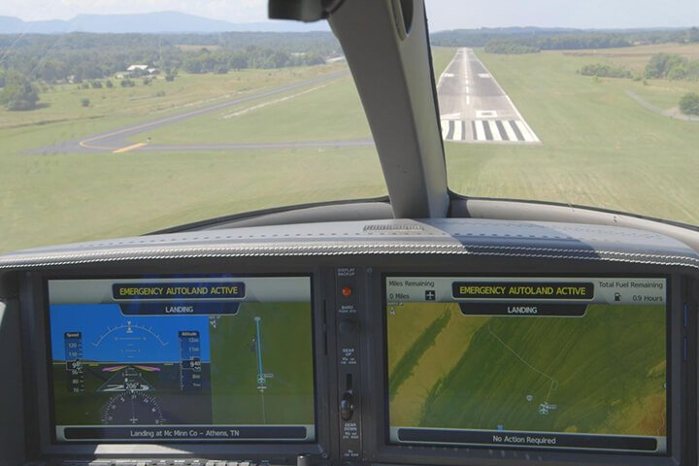
Autopilots - principles

Slide 12
Autopilots – principles – Garmin video

